Slide 1

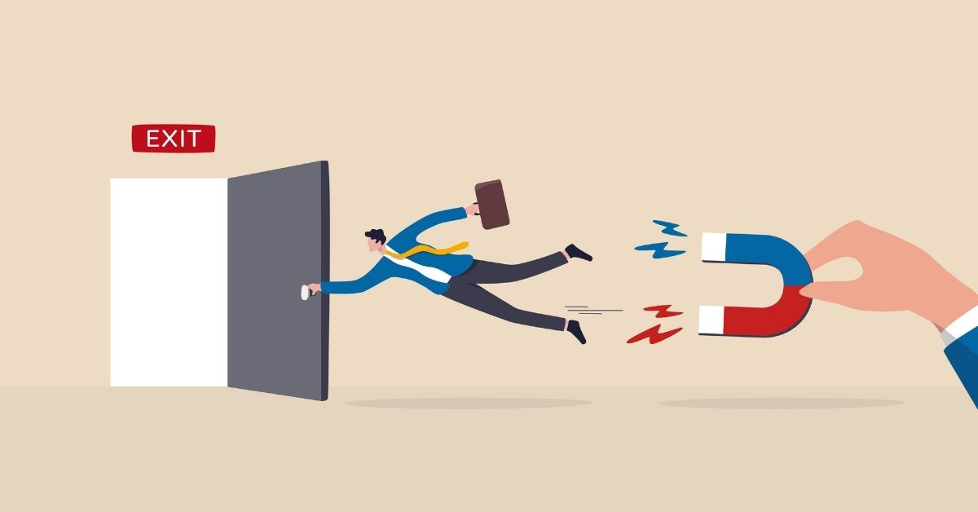
Customer Churn
Customer Churn
Bernard Opoku
Presendeted by: Mert Yigitcan

Slide 2
OUTLINE
Abstract
Design
Data
EDA
Modelling
Why does it matter?
What are we going to do?
I will build a model to answer questions like "Looking at this customers given data, will he/she churn in X months"
Telco Dataset-Kaggle
21 Initial Features – Mixed
Visualation of data
What do we want to achieve?
What is our use case?
What will be our solution to churn?
Notes:
Abstract: Customer Churn nedir?
Design: Müşterinin terkedip terketmeyeceği ni bulmak
Modelling:

Slide 3

ABSTRACT
Customer churn refers to the process of identifying customer/ clients who will terminate their relations with an organisation.
The purpose of this project is to build a model to predict if a given customer will churn or not churn using various classification algorithms and techniques
Notes:
Müşteri kaybı, bir kuruluşla ilişkilerini sonlandıracak müşteri/müşterileri belirleme sürecini ifade eder.
Bu projenin amacı, çeşitli sınıflandırma algoritmaları ve teknikleri kullanarak belirli bir müşterinin kaçıp ayrılmayacağını tahmin etmek için bir model oluşturmaktır.

Slide 4
DESIGN
For the purpose of the business, I ensured that we catch as much churns, so we will make recall and f1 score our priority.
I built upon that by using various techniques like class imbalance techniques, cross-validation to achive an optimal F1-score which we are about.

Slide 5

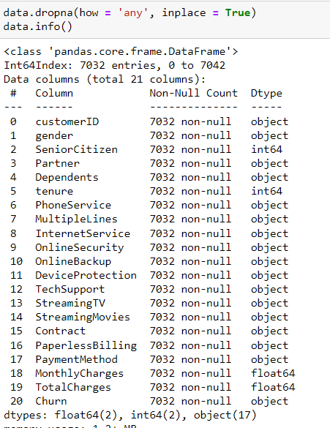

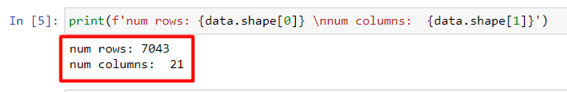
Telco Dataset-Kaggle
21 Initial Features – Mixed
~7.5K observations
Data
Data Acquisition &
Storage

Slide 6
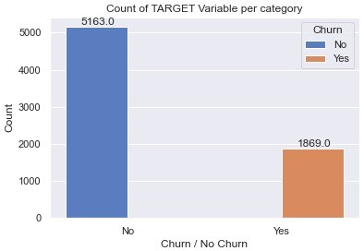
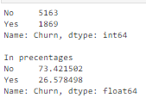

Data Exploration

Slide 7
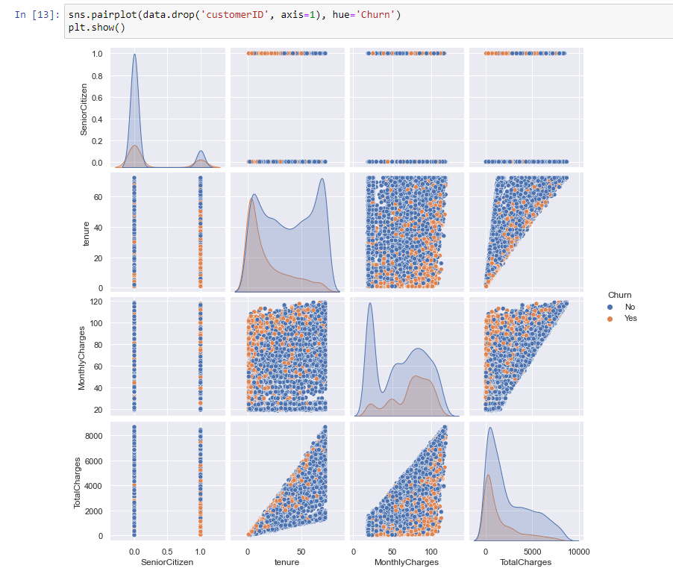
Data Exploration

Slide 8

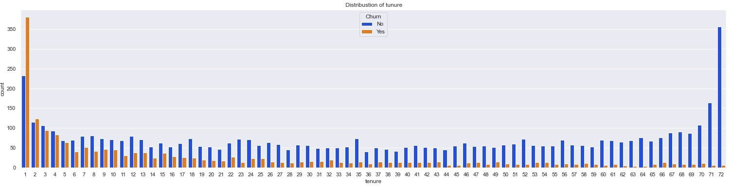
Tenure

Slide 9
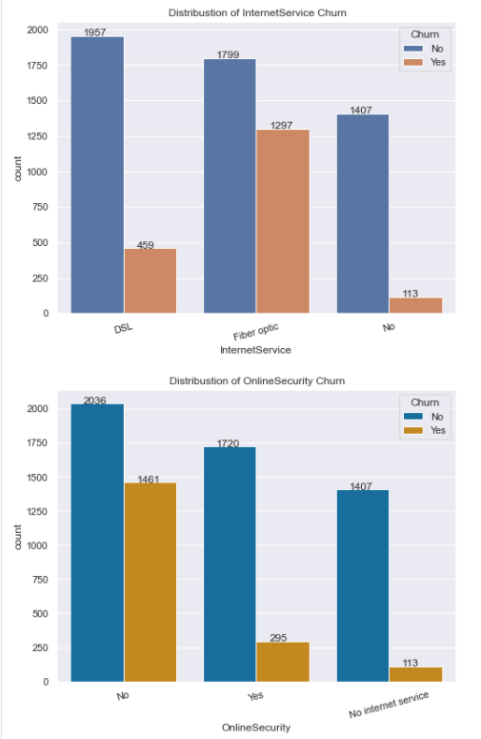
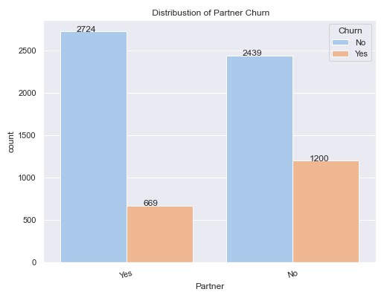
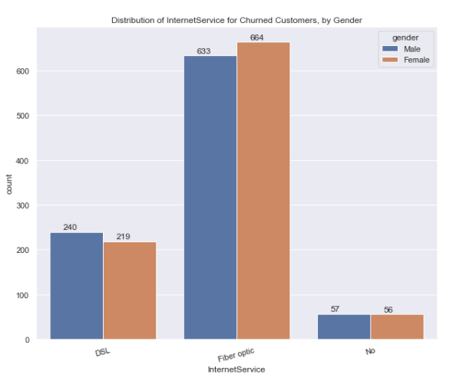
Data Exploration
Distrubution of Partner Churn
Distrubution of Internet Service for Churned by Gender

Slide 10
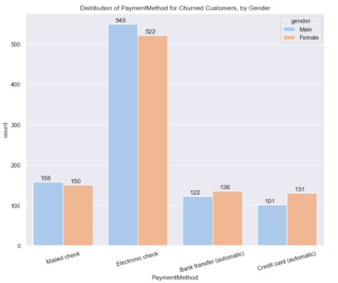
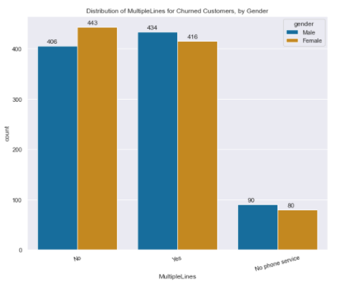
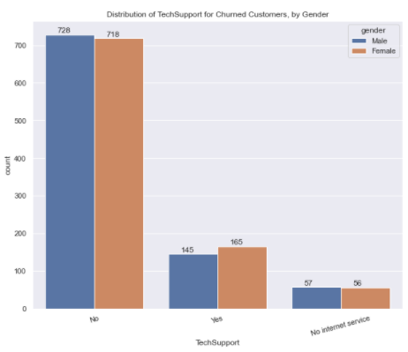
Data Exploration
Distrubution of Payment Method for Churned by Gender
Distrubution of Multiple Lines for Churned Customers by Gender
Distrubution of Tech Support fro Churned Customers by Gender

Slide 11



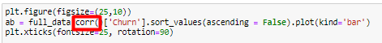
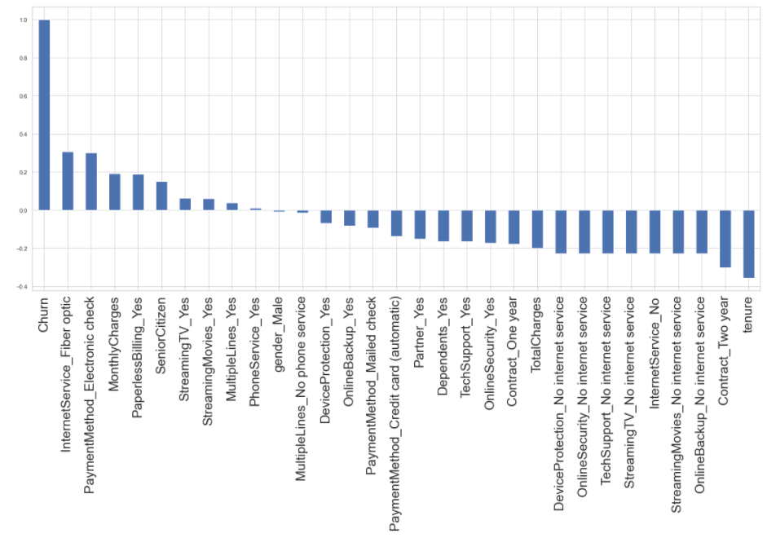
Before Modeling

Slide 12
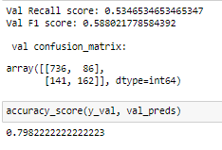
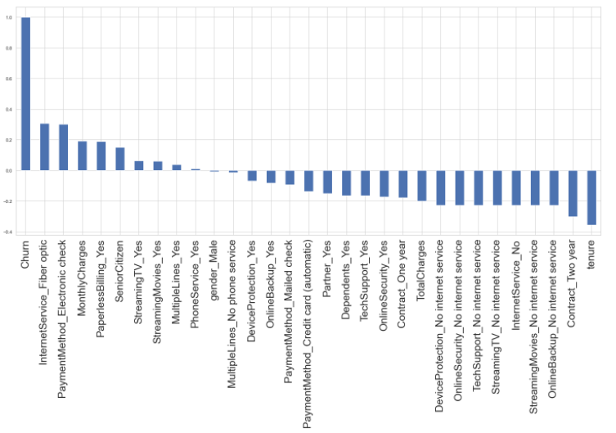
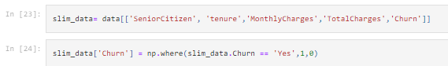
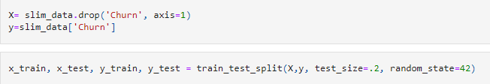
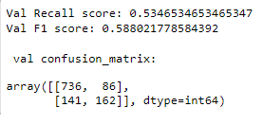
Modelling
Baseline with simple Logistic regresion with the few numerical features
The priority is f1 scores so I found a way to increase f1 as much as possible
I brought in all data including categorical ones, then make dummies for it

Slide 13
Modelling
Test Different Models
Every Model:
Bring in all our our feature
Make them usable by the model (dummy)
Cross- Validation
Class Imbalance Techniques
Logistic Regression as baseline
Recall: 0.5346
F1 Score : 0.588
…Ooopsss!!

Slide 14
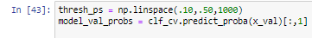
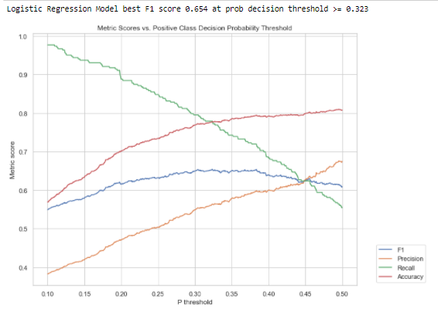
Focus on Imbalance tecniques.
F1
Precession
Recall
Accurancy

Slide 15
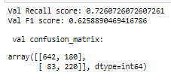
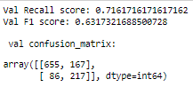
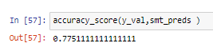
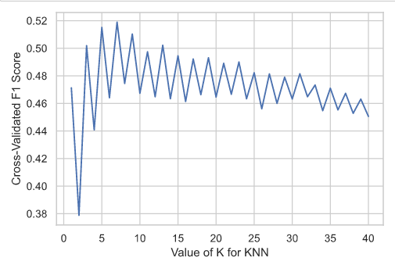
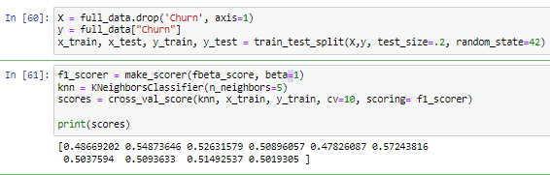
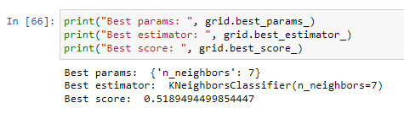
ADASYN
SMOTE
KNeigbhbors
GridSearchCV

Slide 16
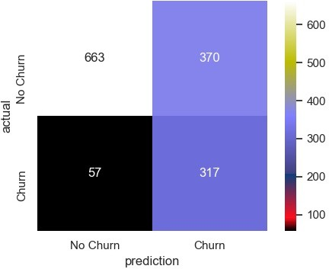
Random Forest
Combine Val and test
Fit
Results:
Threshold @ .21

Slide 17

Questions??
Thank you

